Slide 1
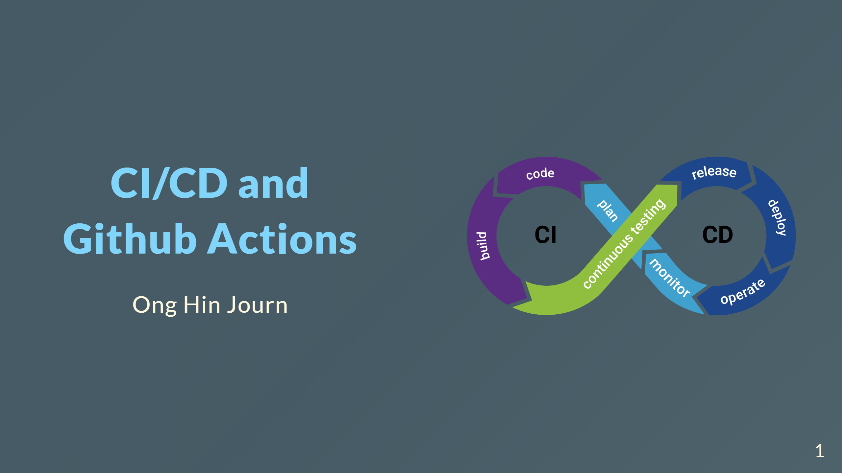

Slide 2
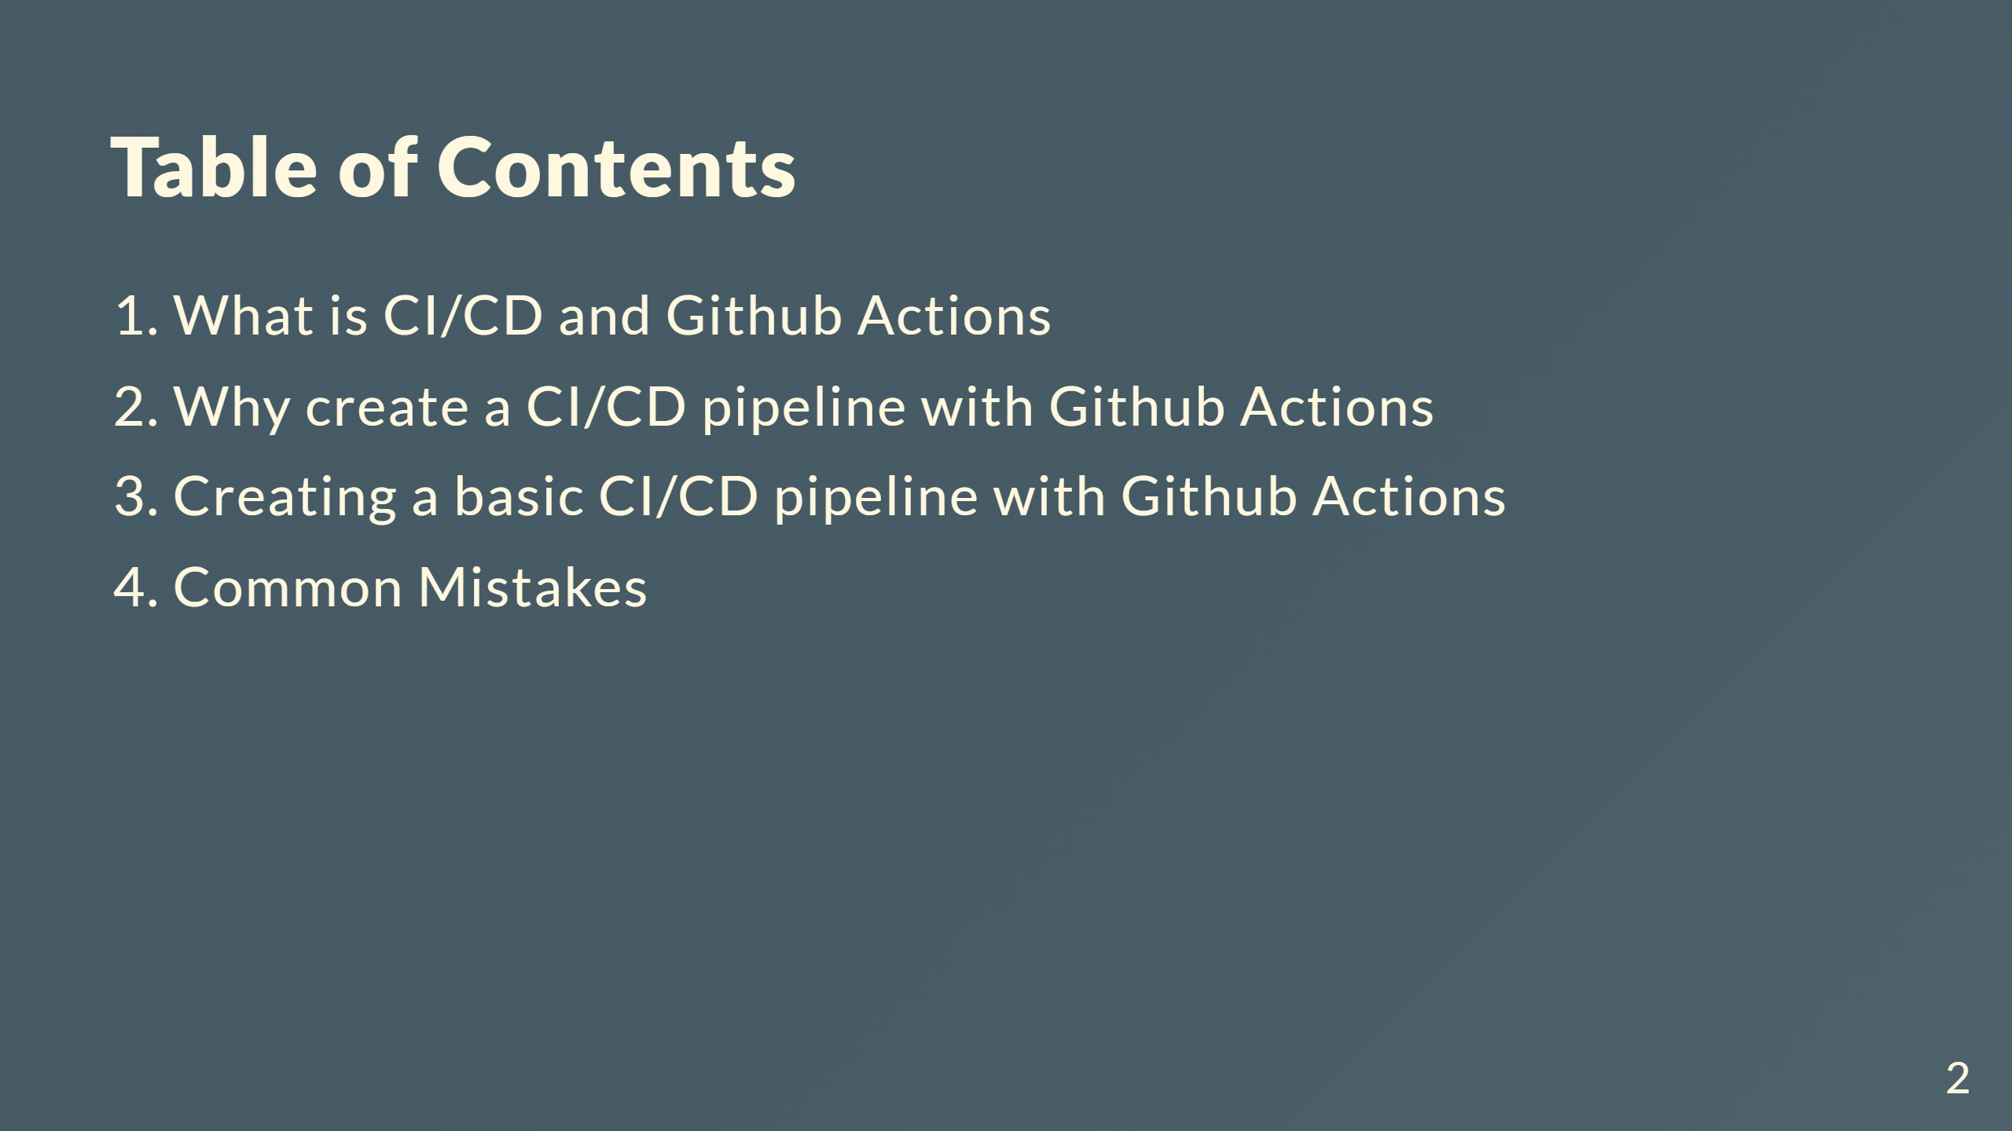

Slide 3
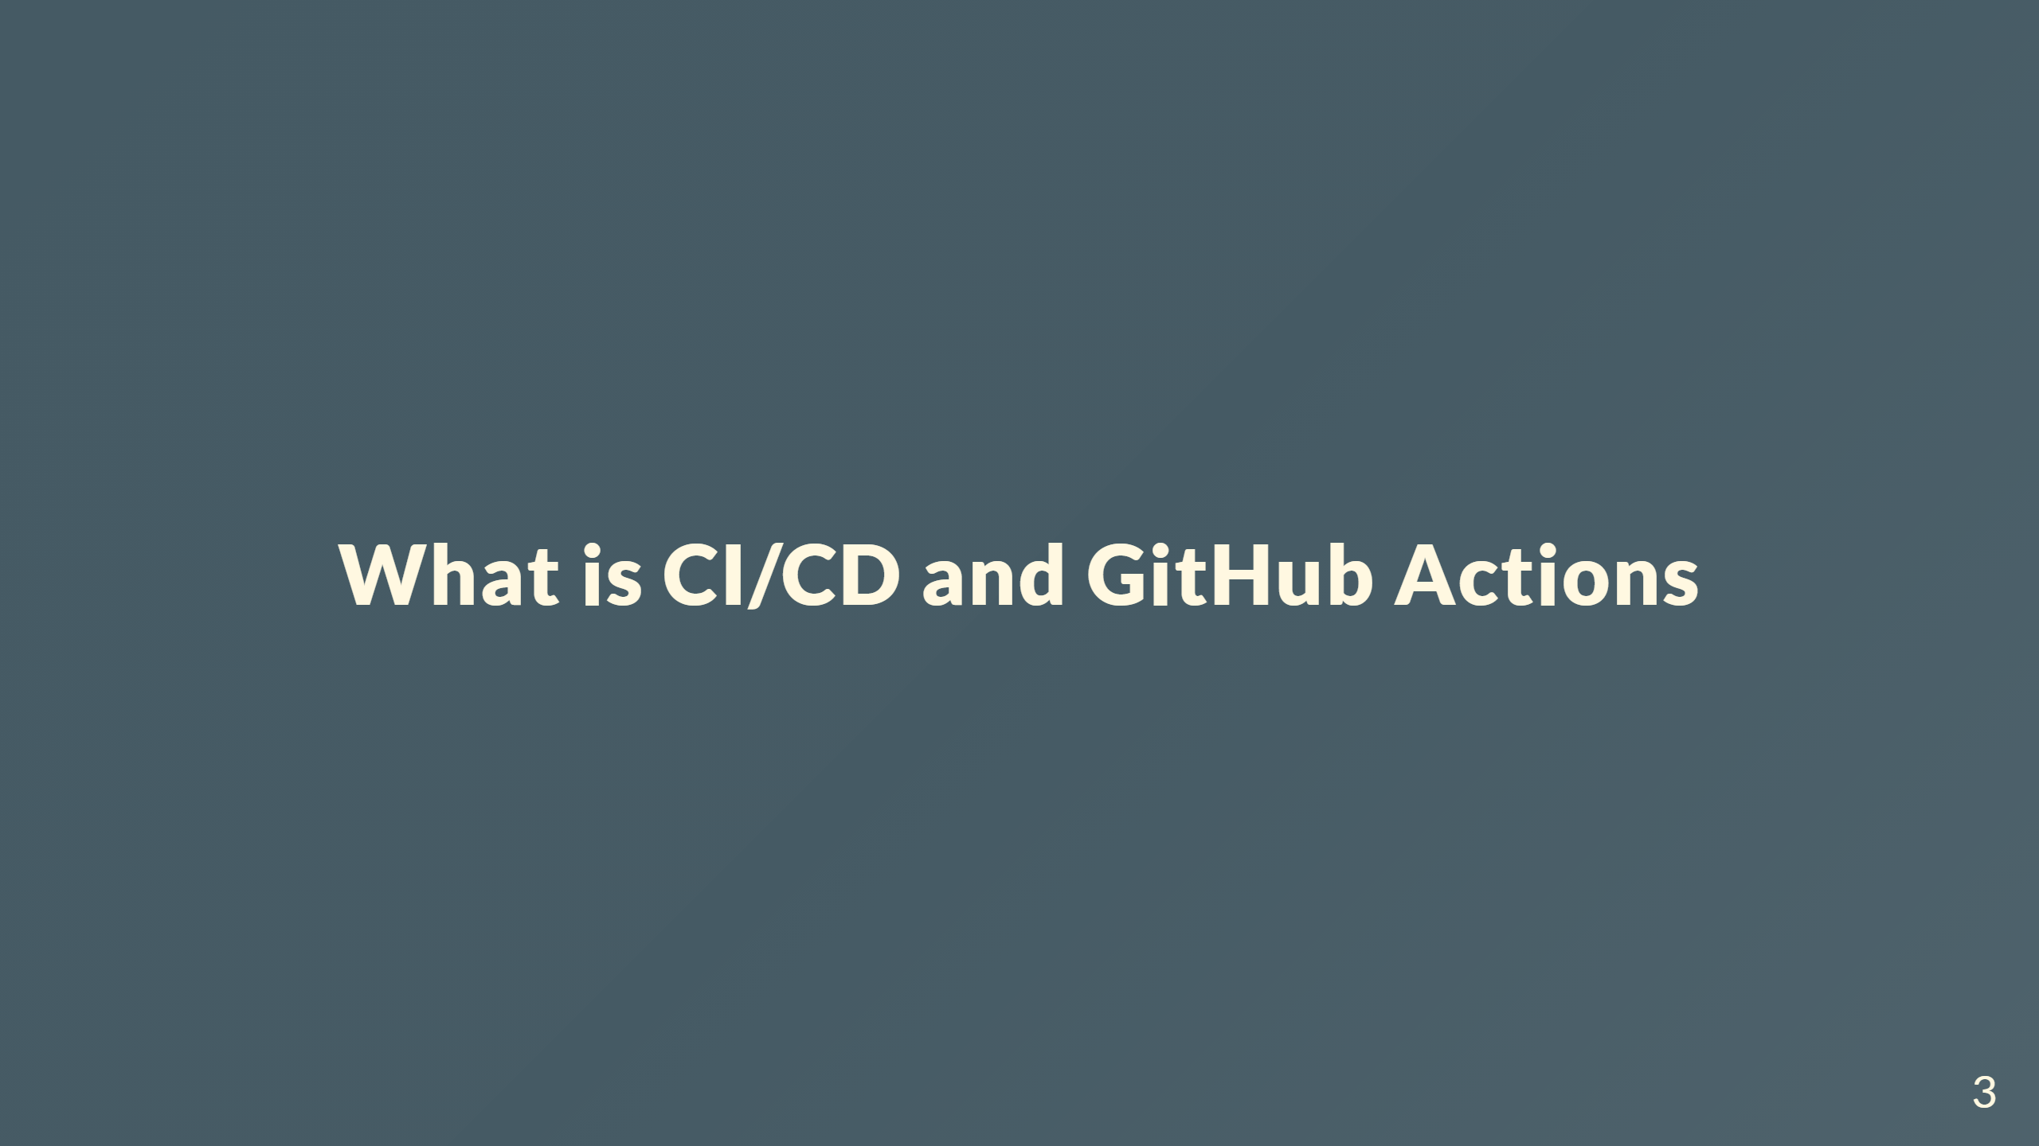

Slide 4
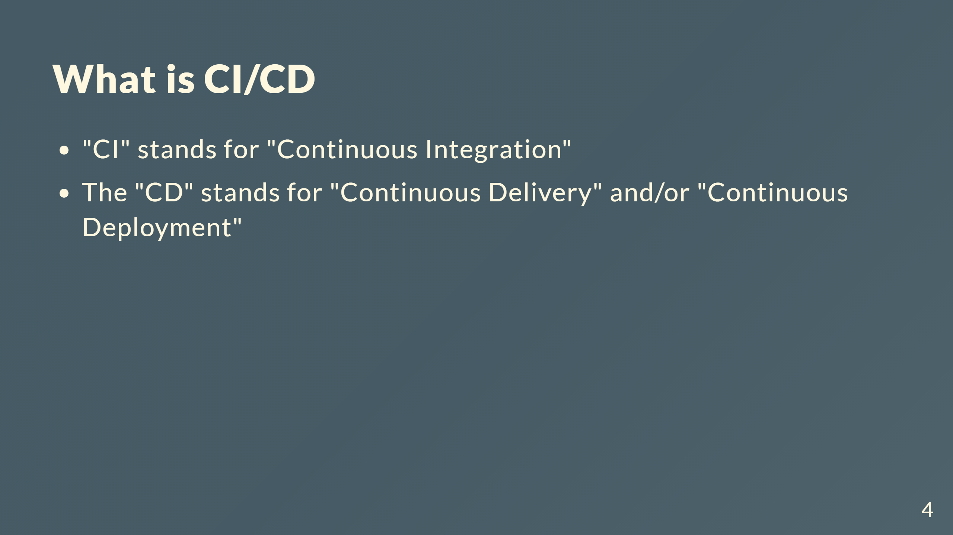
Notes:
Continuous Integration is the automation process of building, testing, and merging code changes of an app to a shared repository. Continuous Delivery ensures that it takes little effort to deploy new code that has been automatically tested and uploaded to the repository. Continuous Deployment is similar to Continuous Delivery, but instead of deploy new code, it releases changes from repository to production. This new release is usable by customers.

Slide 5
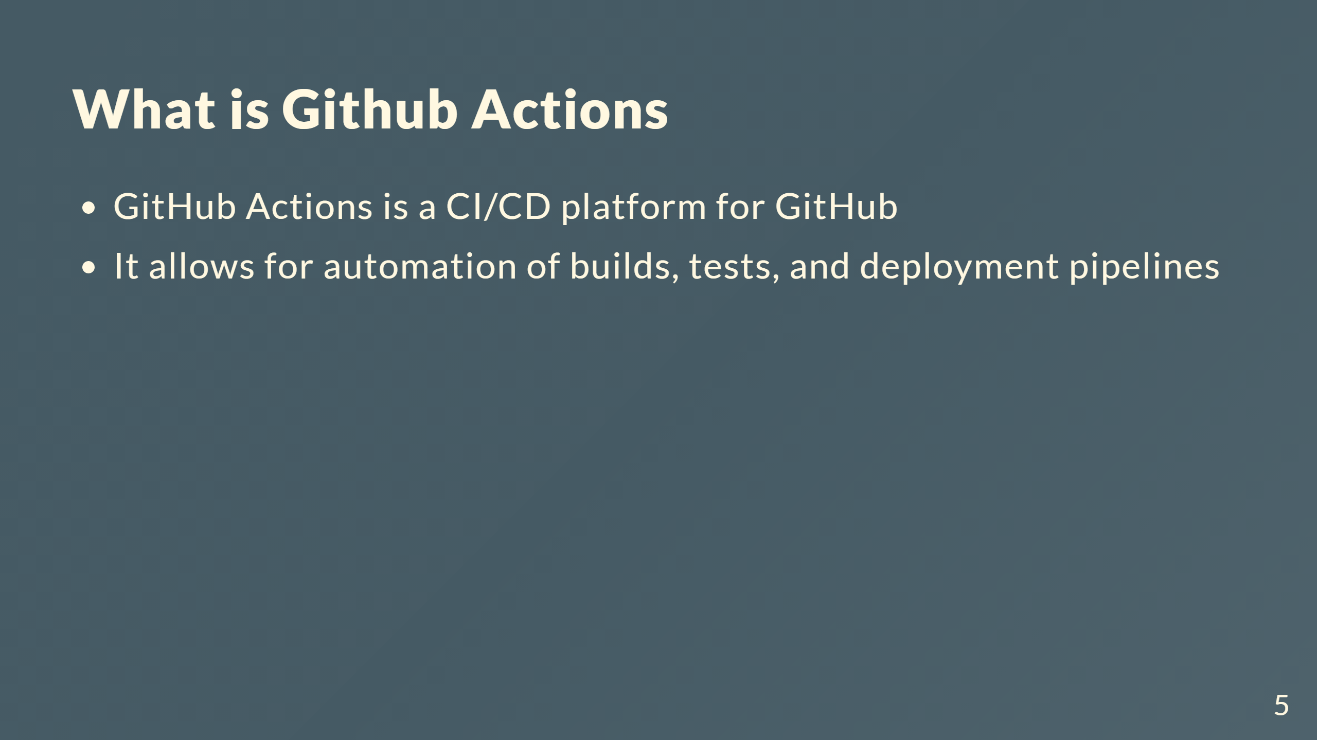
Notes:
GitHub provides Linux, Windows, and macOS virtual machines to run your workflows, or you can host your own self-hosted runners in your own data center or cloud infrastructure.

Slide 6
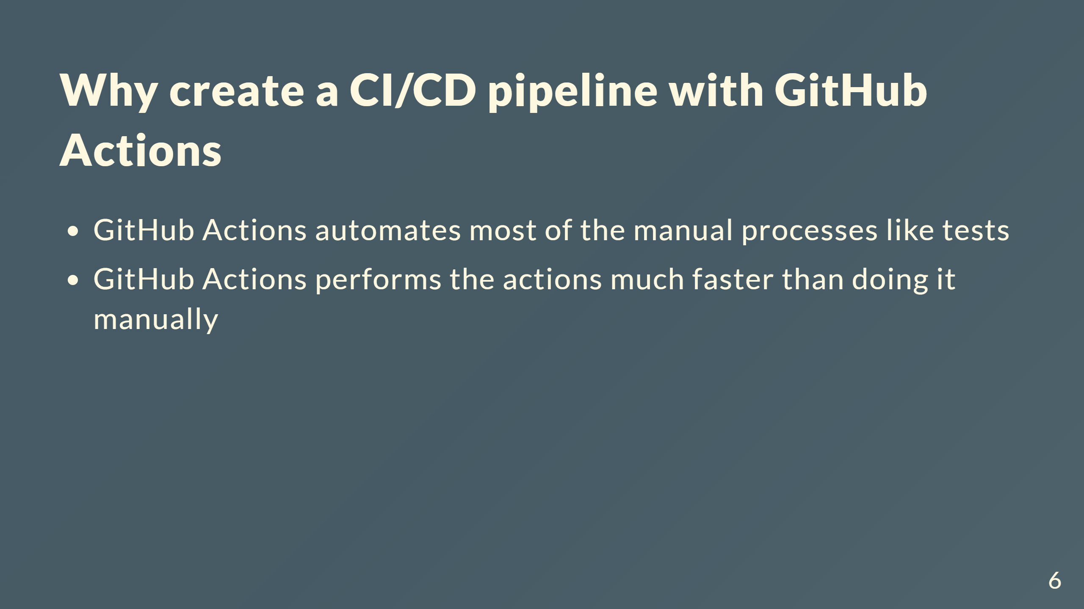

Slide 7
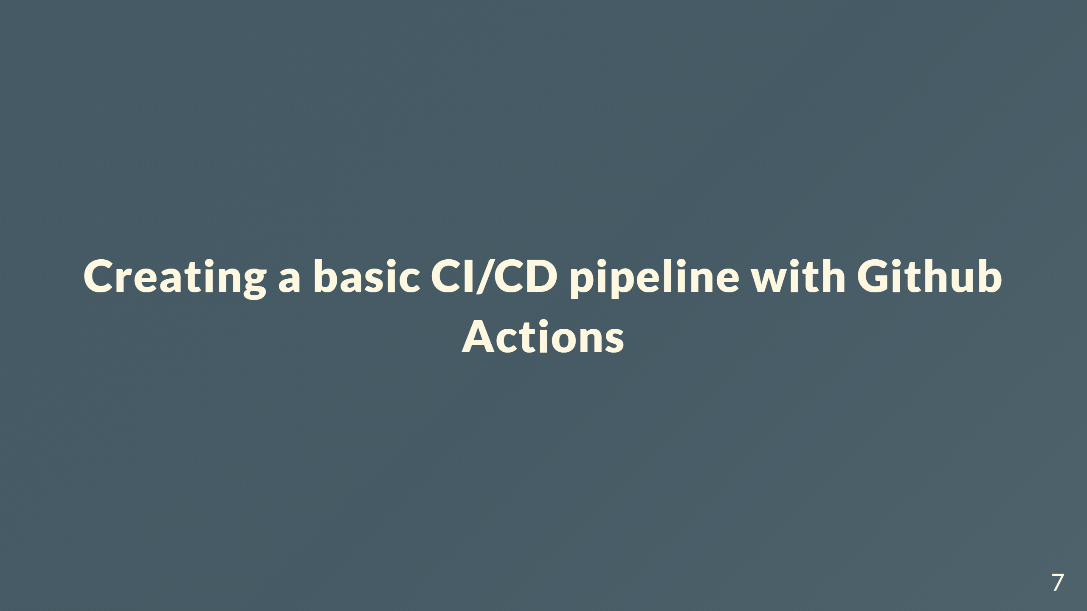
Notes:
This workflow will be a basic workflow testing the build of the application on every pull request made to main branch

Slide 8
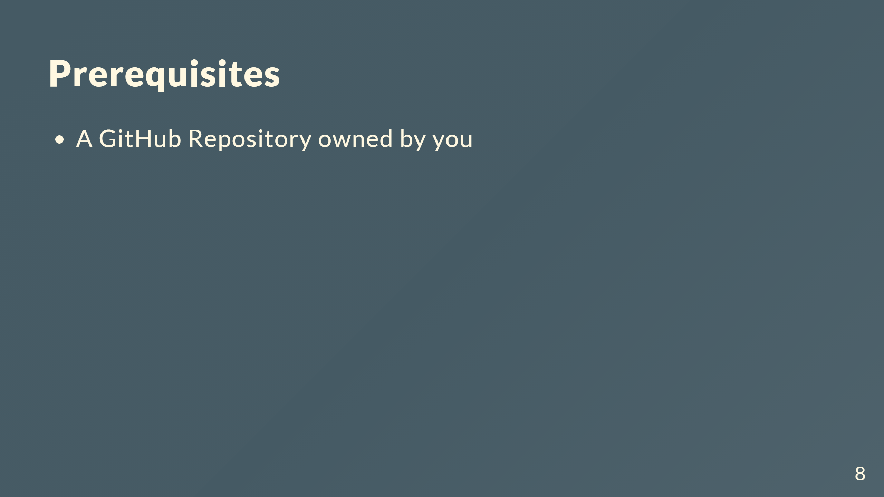
Notes:
This example will be from my Bloggers app

Slide 9
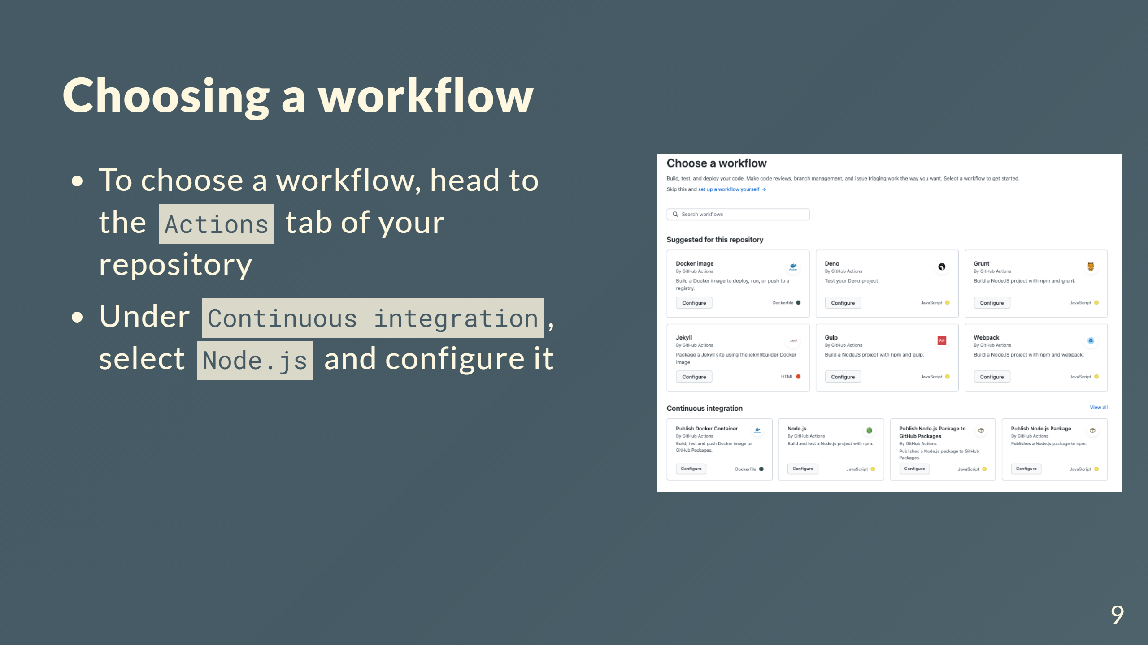

Slide 10
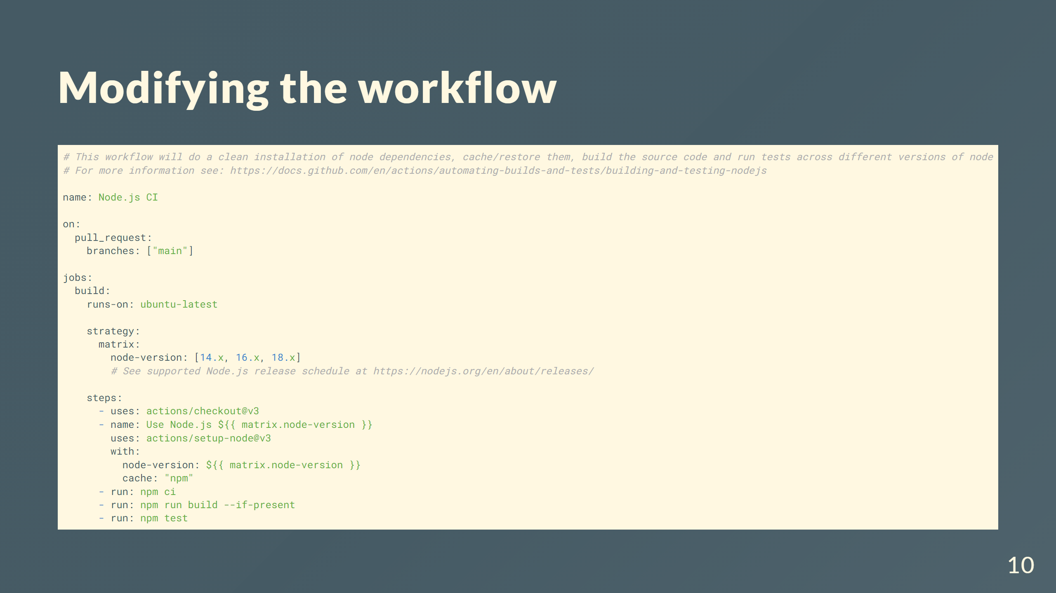
Notes:
I modified the workflow to suit it like this etc etc. Sometimes people using pnpm instead of npm etc.

Slide 11


Slide 12
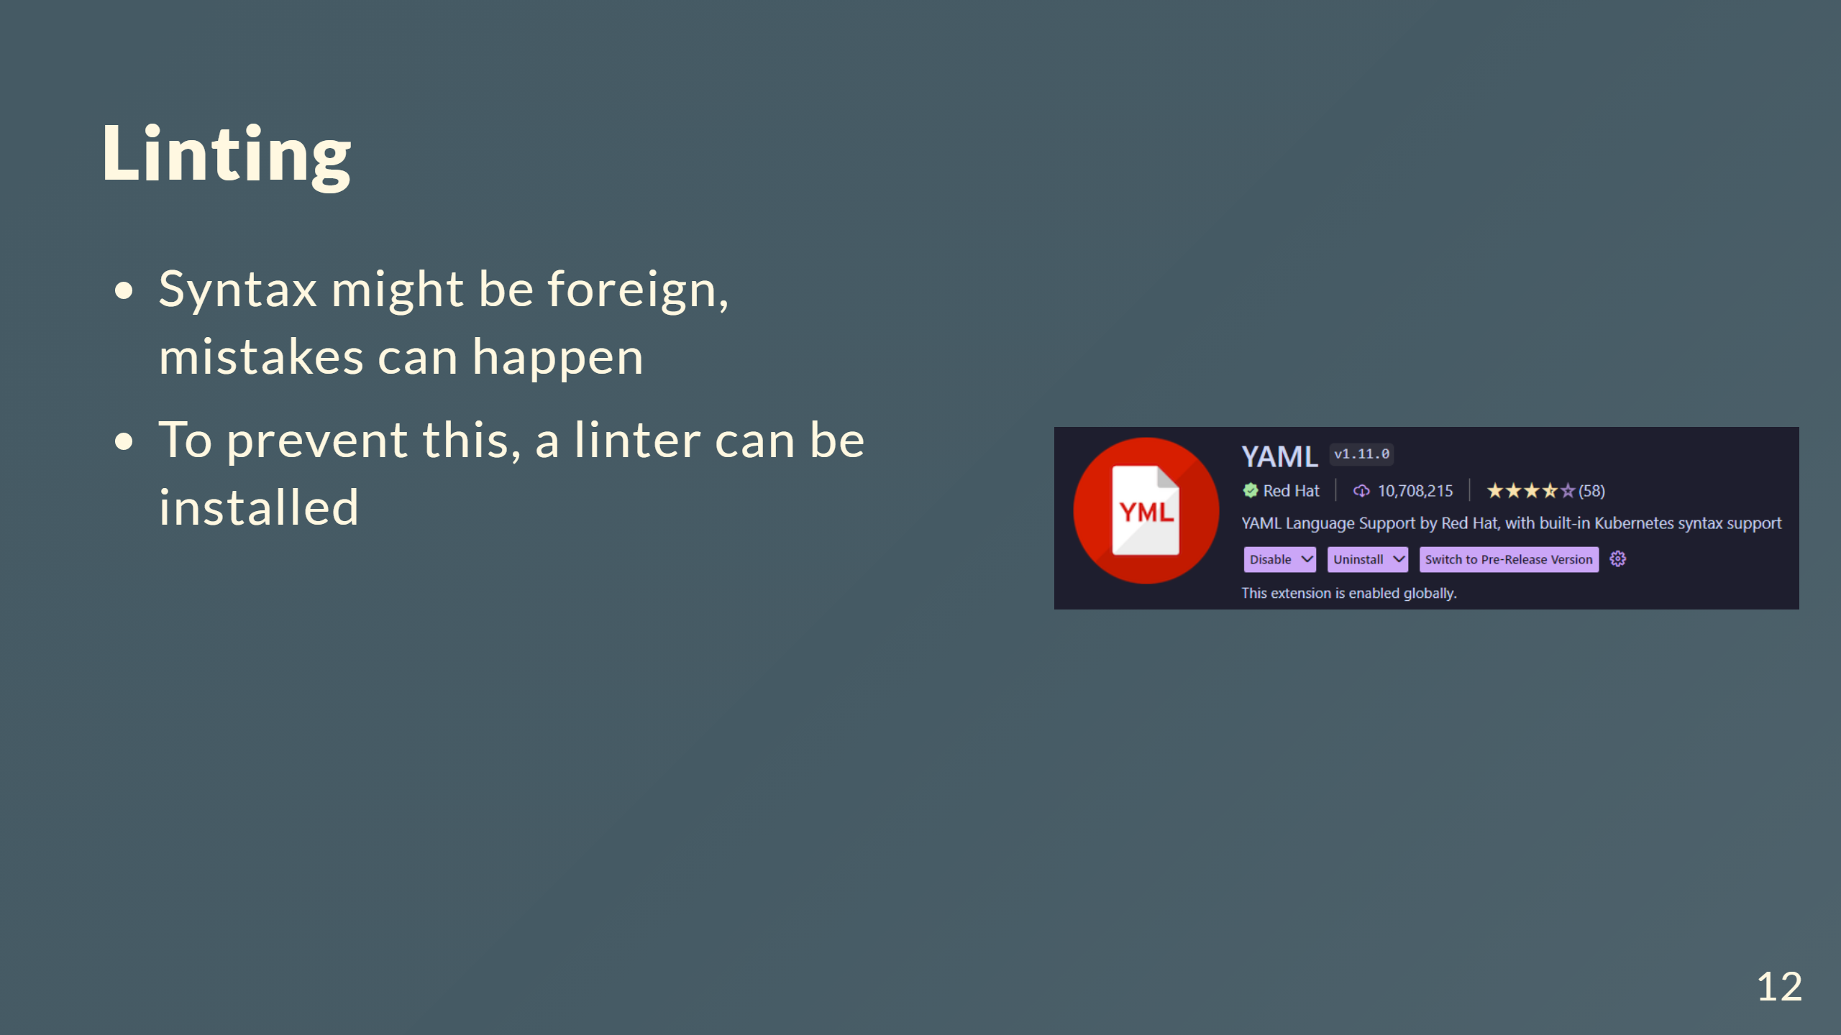

Slide 13
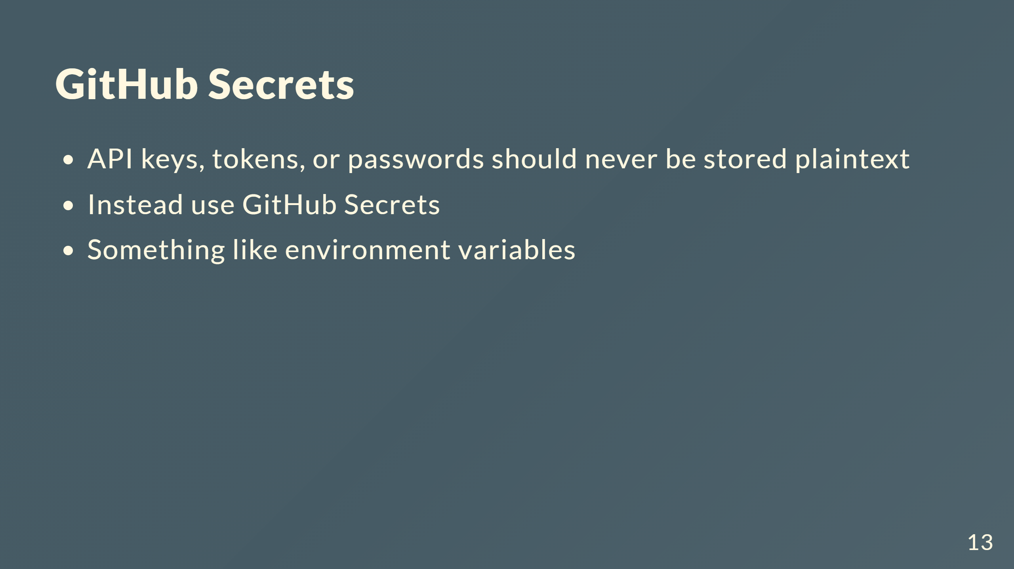

Slide 14
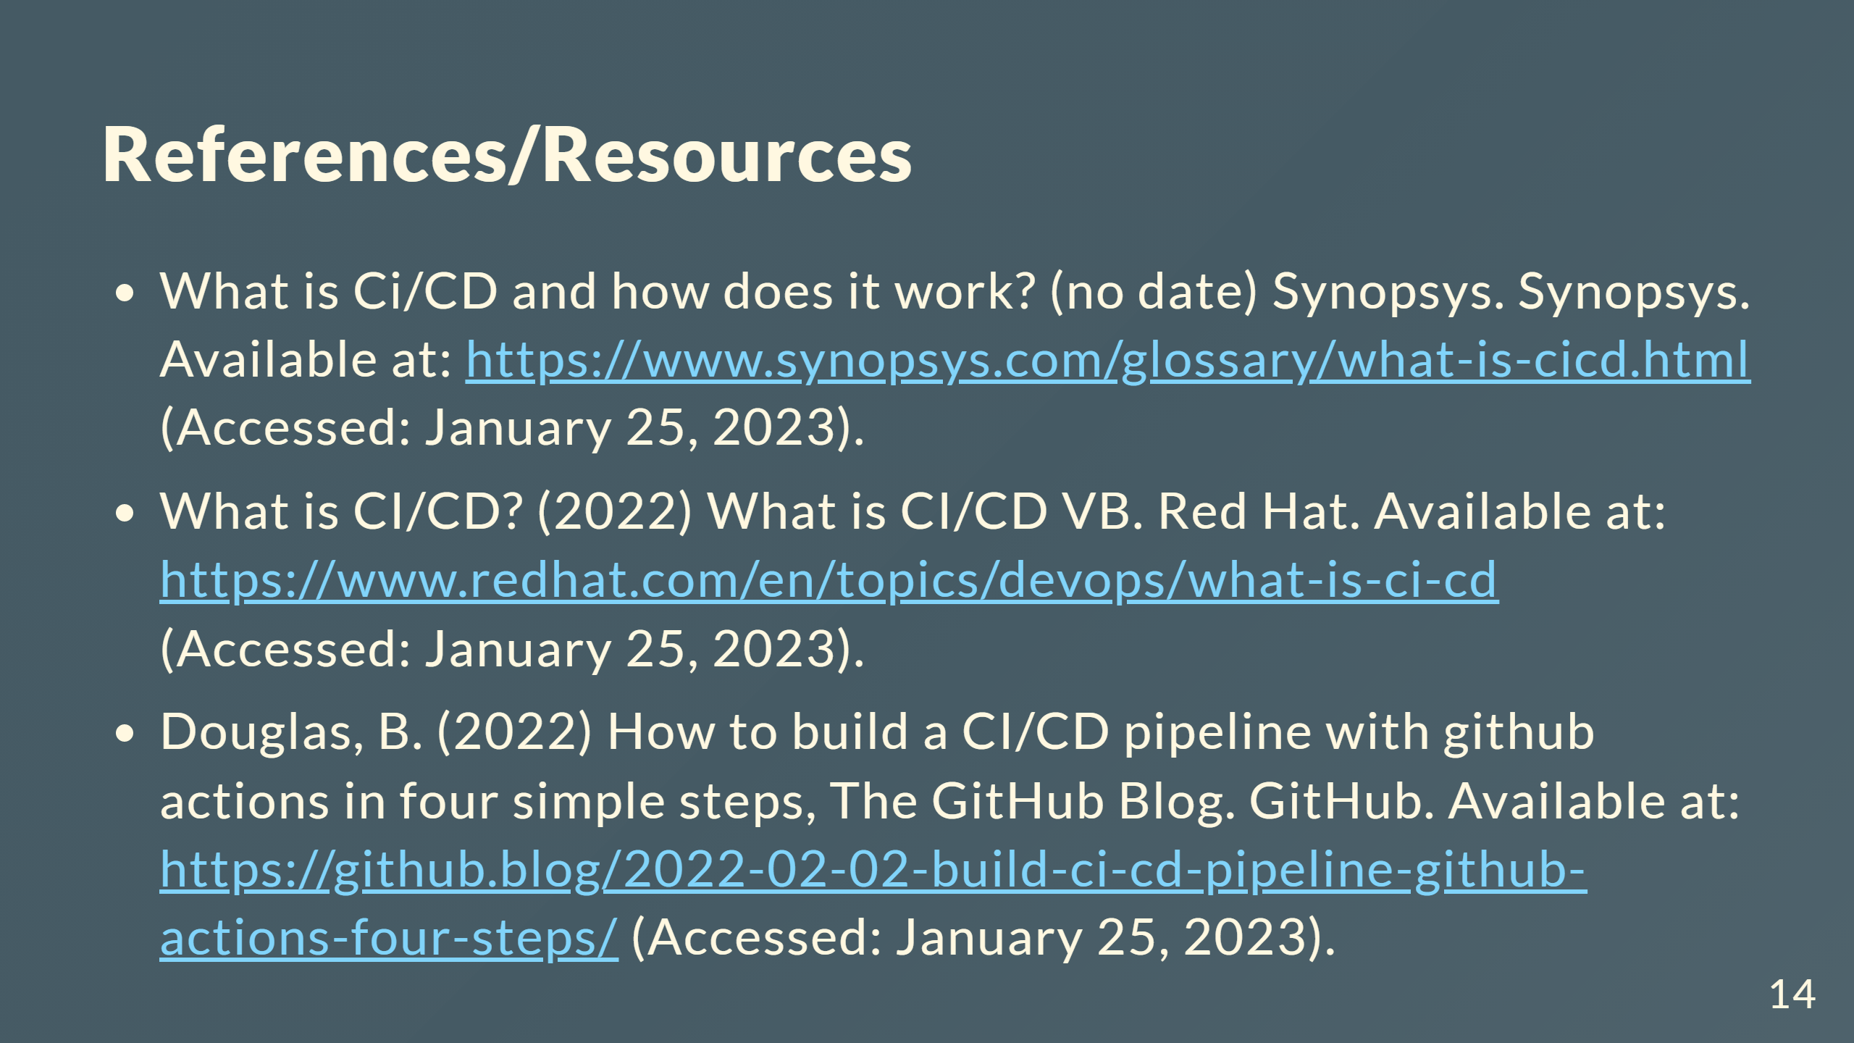

Slide 15
